Slide 1


Intellectual Property and Technology Transfer The What, The Why and The How
Office of Commercialization
Washington State University

Slide 2

What is Intellectual Property?
Property created in the mind. Creativity and innovation can be owned (and licensed and sold) in the same way as physical property.
Copyrights (federal law) - Books, Movies, Music
Trade Secrets (state law) - Product Formulas, Production Processes
Trademarks (federal/state law) - Packaging, Branding, Business Name
Patents (federal law) - Technical Achievements

Slide 3



Copyrights ©
Protects an author’s artistic expression in a literary work, musical work, computer software, video, motion picture, sound recording, photo, sculpture, etc.
“Copyright protection subsists from the time the work is created in fixed form.”
Can register the “work” with the US Copyright Office ($45). http://www.copyright.gov/
Copyright Term Extension Act (CTEA) “For works created after January 1, 1978, copyright protection lasts for the life of the author plus an additional 70 years.”

Slide 4






Trademarks
A trademark, is a distinctive sign or indicator used by an individual, business organization, or other legal entity to identify for consumers that the products or services on or with which the trademark appears originate from a unique source, designated for a specific market, and to distinguish its products or services from those of other entities.
Trademarks rights must be maintained through actual lawful use of the trademark.
These rights will cease if a mark is not actively used for a period of time, normally 5 years in most jurisdictions
Can exist in perpetuity

Slide 5

Trade Secrets
A trade secret is information that:
is not generally known to the public
confers some sort of economic benefit on its holder (where this benefit must derive specifically from its not being generally known, not just from the value of the information itself)
is the subject of reasonable efforts to maintain its secrecy

Slide 6
Patent
It consists of a set of exclusive rights granted by a sovereign state to an inventor or their assignee for a limited period of time in exchange for the public disclosure of an invention.
Almost “anything under the sun made by man” is patentable

Slide 7
What is not patentable?
Laws of nature
Physical phenomenon
Abstract ideas
Literary, dramatic, musical, artistic work (use copyrights)
Non-useful ideas
Morally offensive ideas

Slide 8
Four types of Patents
Utility Patent
A useful invention that is a process, a machine, a manufacture, a composition of matter or an improvement
Design
Innovative, nonfunctional and part of a functional manufactured article
Plant
Any asexually reproduced plants that are both novel and non-obvious (other than tuber propagated)
PVP
Any sexually reproduced or tuber propagated plants that are both novel and non-obvious

Slide 9
Utility Patent
Strongest form of protection
Describes invention and scope of the protection granted in claims
In return of full disclosure, exclusive rights (for a limited period) can be obtained, preventing copying through reverse engineering or competitors to use your patented idea without a license

Slide 10
What is in a patent?
Important dates

Slide 11
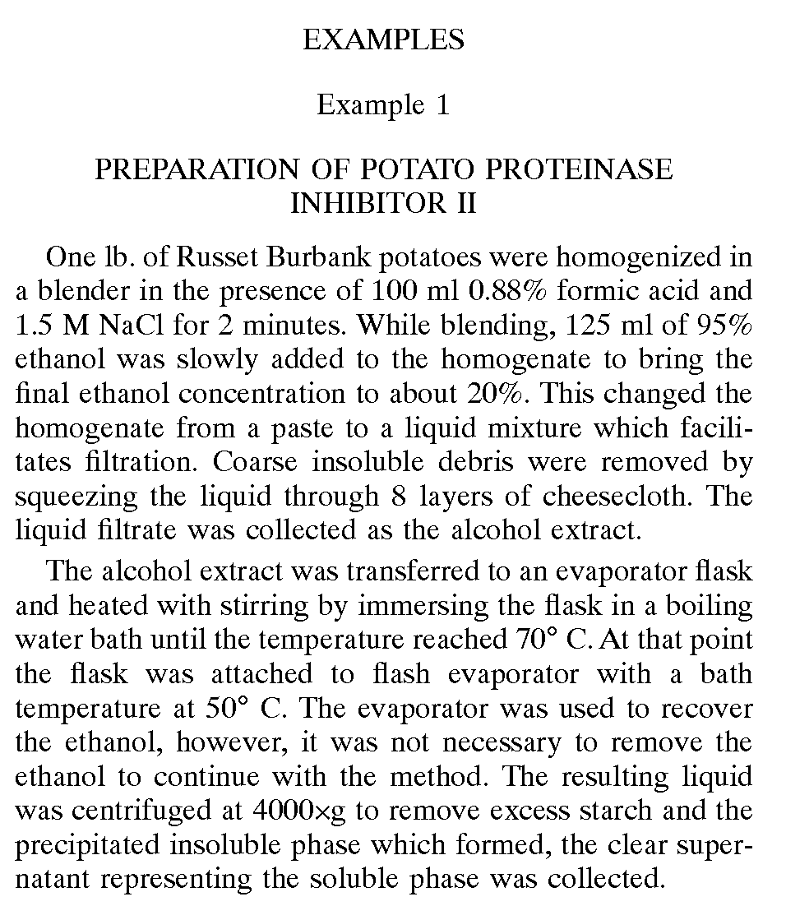
What is in a patent?
Patents are supposed to teach

Slide 12
What is in a patent?
Claims are the heart of the patent

Slide 13
IP protection and Tech transfer is Important….Why?
PHILOSOPHICAL
Enables research to directly benefit the public
Past 30 years-
153 new FDA-approved drugs, vaccines, or new indications for existing drugs were discovered through research carried out in Public sector research institutes

Slide 14
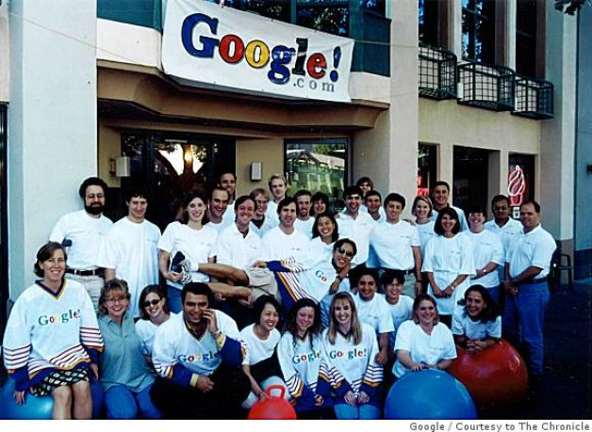
IP protection and Tech transfer is Important….Why?
FINANCIAL
Sergey Brin and Larry Page developed search engine (basis of Google)while working on a university funded project while at Stanford.
Google pays Stanford a license fee for it’s search technology. In 2004, Stanford gained $15.6M from Google’s IPO, retained a stake valued at $140M

Slide 15
IP protection and Tech transfer is Important….Why?
PERSONAL
Financial returns
May lead to additional industry R&D funding for inventors
May lead to consulting work with licensees.
May lead to employment for inventors- alumni students can be employed by licensee

Slide 16
So you have an invention!
A new plant variety
A novel method to isolate a natural compound
Set of genes that encode for a useful product
A useful tool that increases efficiency
Or something you think is super cool but not sure…….

Slide 17
Step 1.
Discuss with your PI and determine inventorship

Slide 18
Inventorship vs. Authorship
Authors of papers are not necessarily inventors.
Inventorship determined by legal criteria, and based on claims.
Example:
A designs a novel semiconductor device, B grows &
fabricates the device & C measures the device.
● A, B, C write a paper on a novel semiconductor device.
● Assume the device design is patentable.
● A is an inventor AND an author.
● B & C are only inventors if somehow they contribute to the design.
● If B determines a new set of growth conditions are required to
achieve a given structure, or modifies the design to overcome
practical challenges (e.g. use a superlattice), this is inventive.
● If, based on measurements, C suggests modifications to the
design to make the device perform better, this is inventive.

Slide 19
Step 2.
Submit an invention disclosure
http://commercialization.wsu.edu/Inventors/Disclose.html

Slide 20
Invention Disclosure to Patent
Internally
Disclosure received and logged
Review
Read and understand the technology
Schedule a meeting with the inventor
Decision to file
IP diligence
Market diligence

Slide 21
Ways to lose patent rights (Barred)
Patent right to an otherwise eligible invention will be lost if:
The inventions is used publicly
The invention is sold or offered for sale
Invention is published in a printed publication (paper/ conference abstract/poster

Slide 22
IP Diligence
Determine patentability
Not Barred
Novel
Non-obvious
Useful

Slide 23
IP Diligence
Become “Barred”
Non-confidential disclosure to others
Poster/oral presentation
Seminar
Published meeting abstract
Published paper (electronic publishing date)
Grant application (abstracts may be published)
Web site
Offer for sale (not offer to license)

Slide 24
IP Diligence
Novel
First to invent
Conception: conceiving the idea of the invention

Slide 25
IP Diligence
Non-obvious (subjective determination by the patent examiner)
Surprising result
Non-trivial modification
Expectation of success

Slide 26
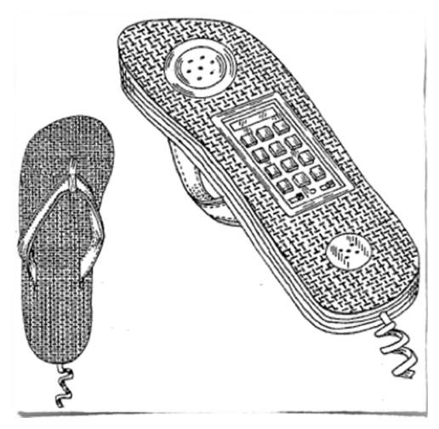
IP Diligence
Useful
The invention must satisfy the “useful” requirement of the patent laws.
The patent system was created as a reward for inventive contributions to society, not merely for creative ideas with no application.

Slide 27
Market Diligence
Identify market
Determine the value proposition (benefit to the customer)
How does this invention differ from those available (novel, efficiency, ease in production)
Market the technology
Non-confidential summary
Confidential information under a non-disclosure agreement

Slide 28
Find the Licensee…….
Ultimate goal is to transfer the technology into marketplace
Funding to support the patent process

Slide 29
Patent Prosecution: cost and time line
Legal fees $8-$50K
Gov’t fees and taxes $8K
International (PCT and Nat’l) $20-$100K
2. File U.S.non-
Provisional
4. Begin US
Prosecution
Phase
5. Enter
National
Stage of PCT
6. First Patent Grant
Issued
1. File provisional
3. File PCT
12 mo.
24 mo.
36 mo.
48 mo.

Slide 30
Example
Disclosed: 1997
Patent filed:1999
US Patent issued:2002
Licensee: 20 year exclusive license signed 1998-2018
Costs: $180,000 +
Patents: US, Australia, Austria, Belgium, Canada, Europe, France, Germany, Ireland, Japan, Netherlands, Portugal, Spain, Switzerland, UK

Slide 31
Contact
Office of Commercialization
Washington State University
Email: commercialization@wsu.edu
Phone: 509-335-5526

