Slide 1
Policy for Risk-Based Security Reviews of Fundamental Research
Bindu R. Nair
Director, Basic Research
OUSD(R&E)
9/12/2023
Controlled by: OUSD(R&E)
Controlled by: Basic Research Office
Category: Unclassified
Distribution: A
POC: Bindu Nair, (571) 372-6418
Distribution Statement A: Approved for public release: distribution unlimited.
Distribution A

Slide 2
Outline
UNCLASSIFIED
Fundamental research and the open research enterprise
Policy on risk-based security review processes pursuant to National Security Presidential Memorandum-33
New risk-based security review policy
DoD Component risk-based security reviews
Mitigation or rejection decisions
Oversight by the Office of the Under Secretary of Defense for Research and Engineering
Decision matrix
1286 lists
UNCLASSIFIED/Distribution A

Slide 3
Securing DoD Dominance in Science and Technology Requires Investment in Open Science
DoD invests in high technology readiness level research to advance known technologies. It has many protections around this type of research and does not conduct it in the open
Investing in today’s known problems is not enough to secure DoD’s future advantage in science and technology
DoD invests in fundamental research to source radical ideas that will lead to breakthroughs that will reshape the military capabilities of the future
Radical ideas come from highly trained highly creative people who are engaged in the global science conversation
DoD only engages in open science when the benefit outweighs the risk
6.7 Operational Systems Development
6.1 Basic Research
6.2 Applied Research
6.3 Advanced Technology Development
6.4 Advanced Component Development Prototypes
6.5 System Development Demonstration
6.6 RDT&E Management Support
UNCLASSIFIED/Distribution A

Slide 4
The Open Research Enterprise
UNCLASSIFIED
This brief is focused solely on proposals for fundamental research conducted by academic institutions. This means:
Research that is largely free from restrictions such as publication reviews or restrictions on foreign nationals.
Fundamental research and open international collaborations are invaluable for scientific creativity that enables the DoD to maintain a competitive research advantage.
The Department is enacting risk-based security reviews of fundamental research projects to comply with National Security Presidential Memorandum - 33
UNCLASSIFIED/Distribution A

Slide 5
DoD’s policy stems from an interagency directive
2021: National Security Presidential Memorandum – 33 (NSPM-33)
NSPM-33 is an interagency coordinated activity to address foreign influence at academic institutions
One directive is that heads of research funding agencies require disclosure of information related to potential conflicts of interest & commitment from participants in Federally-funded R&D
2022 National Science and Technology Council Implementation Guidance states: “Agencies should incorporate measures that are risk-based, in the sense that they provide meaningful contributions to addressing identified risks to research security and integrity and offer tangible benefit that justifies any accompanying cost or burden”
UNCLASSIFIED/Distribution A

Slide 6
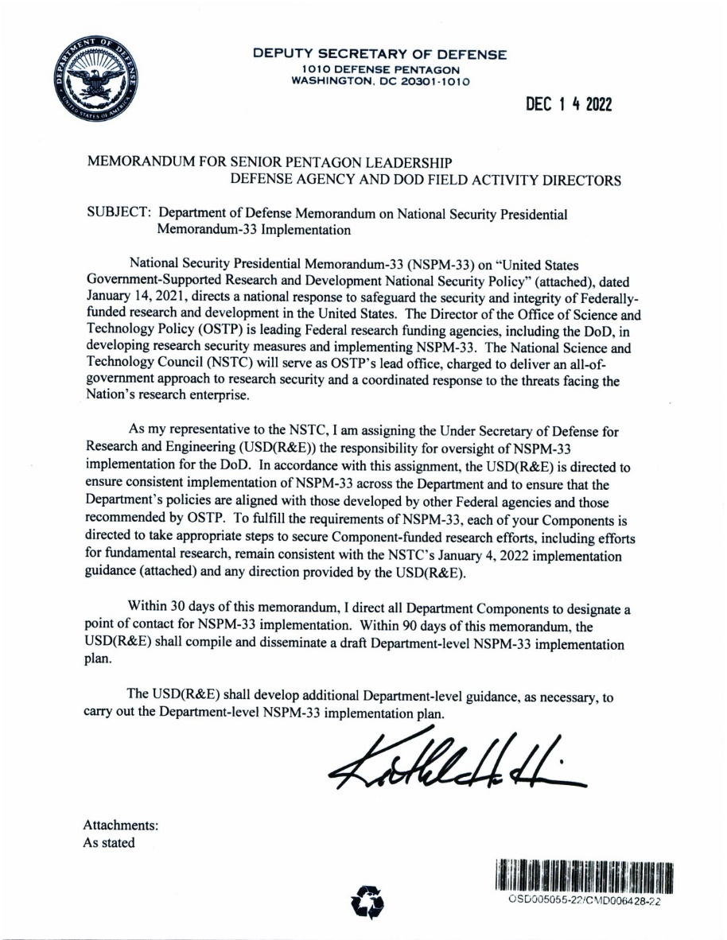
Current status on Department-Wide Risk Based Review Procedures
The Deputy Secretary of Defense signed a memorandum on 14 Dec 2022 on National Security Presidential Memorandum – 33 Implementation
The Office of the Under Secretary of Defense for Research and Engineering (OUSD(R&E)) is directed to ensure a consistent implementation of NSPM-33 across the Department and to ensure the Department’s policies are aligned with the interagency and OSTP
UNCLASSIFIED/Distribution A

Slide 7
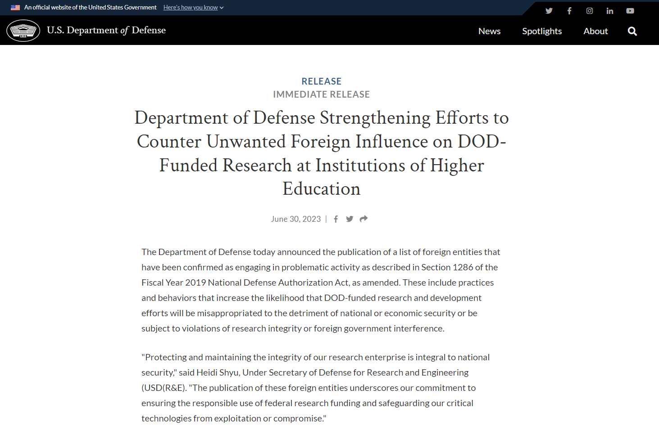
Policy for Risk-Based Security Reviews of Fundamental Research Policy
The Countering Unwanted Foreign Influence in Department-Funded Research Institutions of Higher Education policy and enclosures was publicly released June 30, 2023
Policy for risk-based security reviews of fundamental research
Intent is to ensure consistent application of risk-based security reviews for fundamental research project proposals across the DoD
DoD Component Decision Matrix to Inform Fundamental Research Proposal Mitigation Decisions
A guide to assist program mangers and DoD components in reviewing fundamental research proposals for potential conflicts of interest and conflicts of commitment.
FY22 Lists Published in Response to Section 1286 of NDAA 2019
The 1286 List includes foreign institutions that have been confirmed as engaging in problematic activity as described in Section 1286(c)(8)(A) of the NDAA for FY 2019, as amended. It also identifies the foreign talent programs that have been confirmed as posing a threat to the national security interests of the United States as described in Section 1286(c)(9)(A) of the NDAA for FY 2019, as amended. Per the Decision Matrix, certain engagements with these institutions will require mitigation before a proposal can be funded.
https://www.defense.gov/News/Releases/Release/Article/3445601/department-of-defense-strengthening-efforts-to-counter-unwanted-foreign-influen/
https://media.defense.gov/2023/Jun/29/2003251160/-1/-1/1/COUNTERING-UNWANTED-INFLUENCE-IN-DEPARTMENT-FUNDED-RESEARCH-AT-INSTITUTIONS-OF-HIGHER-EDUCATION.PDF
UNCLASSIFIED/Distribution A

Slide 8
Key Takeaways
The Department is committed to preserving open science, international collaboration, and involvement of talented foreign students and researchers in DoD-funded fundamental research
The Department’s policy is to mitigate potential conflicts of interest listed in the Decision Matrix to the maximum extent possible
Policy implementation will be transparent and consistent across the Department
The Department will not discriminate on the basis of race or national origin
The Department will not penalize researchers for activities believed acceptable prior to the USD(R&E) Griffin Letter to Academia, dated 10 October 2019
The Department is interested in collecting feedback from the academic community as it implements its policy. The decision matrix may be updated to incorporate changes in law and policy, account for lessons learned, and ensure consistency with other Federal agencies.
UNCLASSIFIED/Distribution A

Slide 9
DoD component risk-based security review
Every fundamental research proposal selected for award based on technical merit will undergo a risk-based review
Component policies must:
Ensure a proposal is fundamental research
Use the Decision Matrix
Use the disclosures and Standard Form 424 submitted by the proposing institution for all covered individuals listed in fundamental research project proposals selected for award to identify potential research security risks and employ relevant publicly available information, at a minimum, to verify the information submitted in the disclosures and Standard Form 424
Conduct annual reviews of funded research projects using the Research Performance Progress Report
Not discourage international research collaboration
Not impact time to award if no mitigation is necessary.
Working with the institution to mitigate conflicts of interest may result in additional time to award
Define the level of research security risk mitigation determination that is appropriate for the components to follow their customary process to recommend and make funding decisions and when a decision by component leadership (or designee) is required
UNCLASSIFIED/Distribution A

Slide 10
Mitigating potential risks
Mitigation is the preferred option for Components to take concerning any risks uncovered
Mitigation measure examples:
Require the covered individual(s) to complete insider risk awareness training;
Require increased frequency of reporting by the covered individual(s) through the Research Performance and Progress Report (RPPR);
Replace individuals listed in the fundamental research project proposal who are deemed a research security risk;
Provide DoD the covered individual's(s') contracts for review and clarity relationships, affiliations, and/or associations considered risky; and
Require the covered individual(s) to resign from positions deemed problematic by the risk-based security review.
UNCLASSIFIED/Distribution A

Slide 11
Denials
Denials shall only occur when risks are unable to be mitigated or if required by law
Denials must be explained in writing to proposing institutions, including unclassified rationale
Institutions may challenge a denial and OUSD(R&E) will mediate
UNCLASSIFIED/Distribution A

Slide 12
OUSD(R&E) Oversight
Denials must be reported to OUSD(R&E) and other Components
Components shall provide OUSD(R&E) with a summary of risk-based security reviews including number of reviews, denials, and description of denials on an ongoing basis
OUSD(R&E) may also conduct periodic spot checks independent of the Component process
OUSD(R&E) must ensure that Components’ policies and implementation are in line with other Components’ and Federal agencies’ policies
UNCLASSIFIED/Distribution A

Slide 13
Decision Matrix
UNCLASSIFIED/Distribution A

Slide 14
Decision matrix considers four factors to determine whether mitigation measures are needed
Foreign talent recruitment programs – is a way a Foreign Country of Concern (FCOC) corrupts the open research enterprise by conducting secretive dealings between recipients and the FCOC, including transfer of knowledge and personnel outside of norms
Malign foreign talent recruitment program – defined in CHIPS
Funding sources – accepting funding from FCOCs may create a conflicting obligation to that FCOC
Patents – patents arising from US–funded research filed in a foreign country before being filed in the U.S. can be an indicator of undisclosed agreements with a foreign country
Entity lists – problematic actors that affiliation or association with could create a conflict of interest or conflict of commitment
Affiliation = Academic (not including undergraduate or graduate students), professional, or institutional appointments or positions with a foreign government or a foreign government-connected entity, whether fulltime, part-time, or voluntary (including adjunct, visiting, post-doctoral appointment, or honorary), where monetary reward, non-monetary reward, or other quid-pro-quo obligation is involved.
Association = Academic (not including undergraduate or graduate students), professional, or institutional appointments or positions (including adjunct, visiting, voluntary, post-doctoral appointment, or honorary) with a foreign government or a foreign government-connected entity where no monetary reward, non-monetary reward, or other quid-pro-quo is involved.
UNCLASSIFIED/Distribution A

Slide 15
Prohibited factors – prohibited by law
UNCLASSIFIED/Distribution A

Slide 16
No mitigation needed
UNCLASSIFIED/Distribution A

Slide 17
Mitigation measures suggested
UNCLASSIFIED/Distribution A

Slide 18
Mitigation measures recommended
UNCLASSIFIED/Distribution A

Slide 19
Mitigation measures required, factors discouraged by DoD policy, rejection of proposal if no mitigation possible
UNCLASSIFIED/Distribution A

Slide 20
1286 Lists
FY22 Lists Published in Response to Section 1286 of the John S. McCain National Defense Authorization Act for Fiscal Year 2019 (Public Law 115-232), as amended
UNCLASSIFIED/Distribution A

Slide 21
FY22 Lists Published in Response to Section 1286 of Public Law 115-232, as amended
The 1286 List includes foreign institutions that have been confirmed as engaging in problematic activity as described in Section 1286(c)(8)(A) of the NDAA for FY 2019, as amended. It also identifies the foreign talent programs that have been confirmed as posing a threat to the national security interests of the United States as described in Section 1286(c)(9)(A) of the NDAA for FY 2019, as amended.
Table 1: List of Institutions of the People’s Republic of China, Russian Federation, and other Countries with Specific Characteristics
Table 2: Foreign Talent Programs that Pose a Threat to National Security Interests of the United States
Documentation on problematic behaviors engaged in by the institutions on the 1286 list can be found in USG published sources
Entities List
Justice Department Court Cases
UNCLASSIFIED/Distribution A

Slide 22
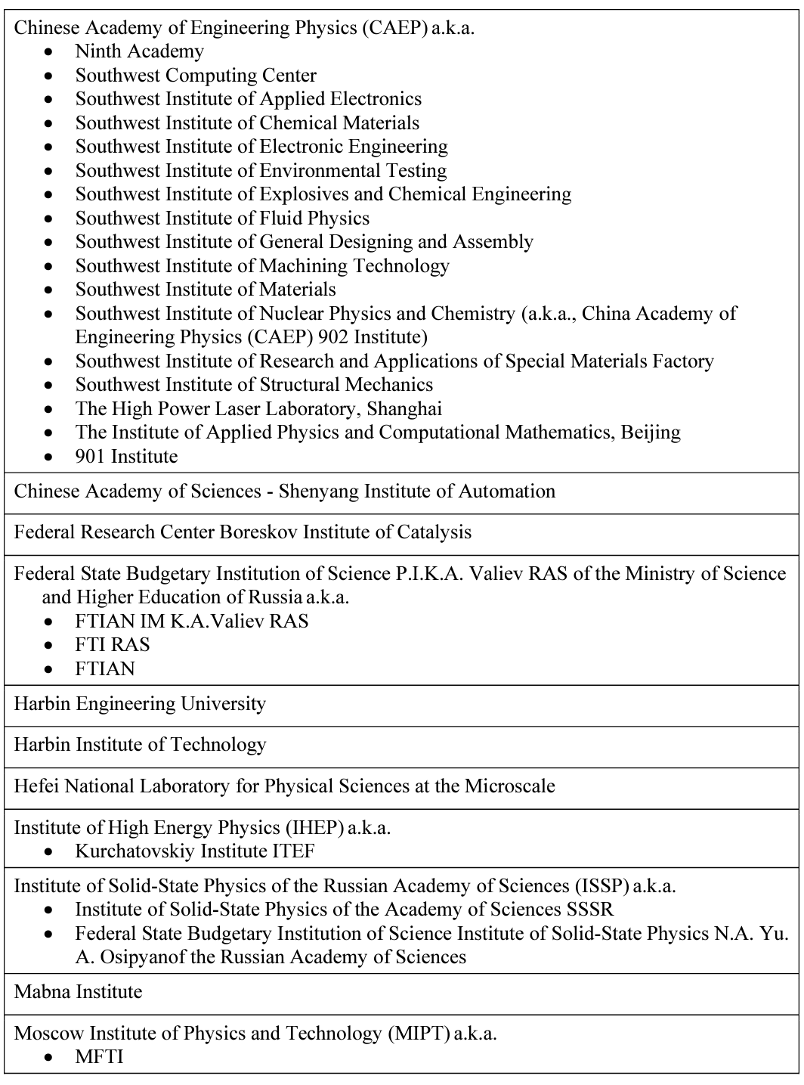
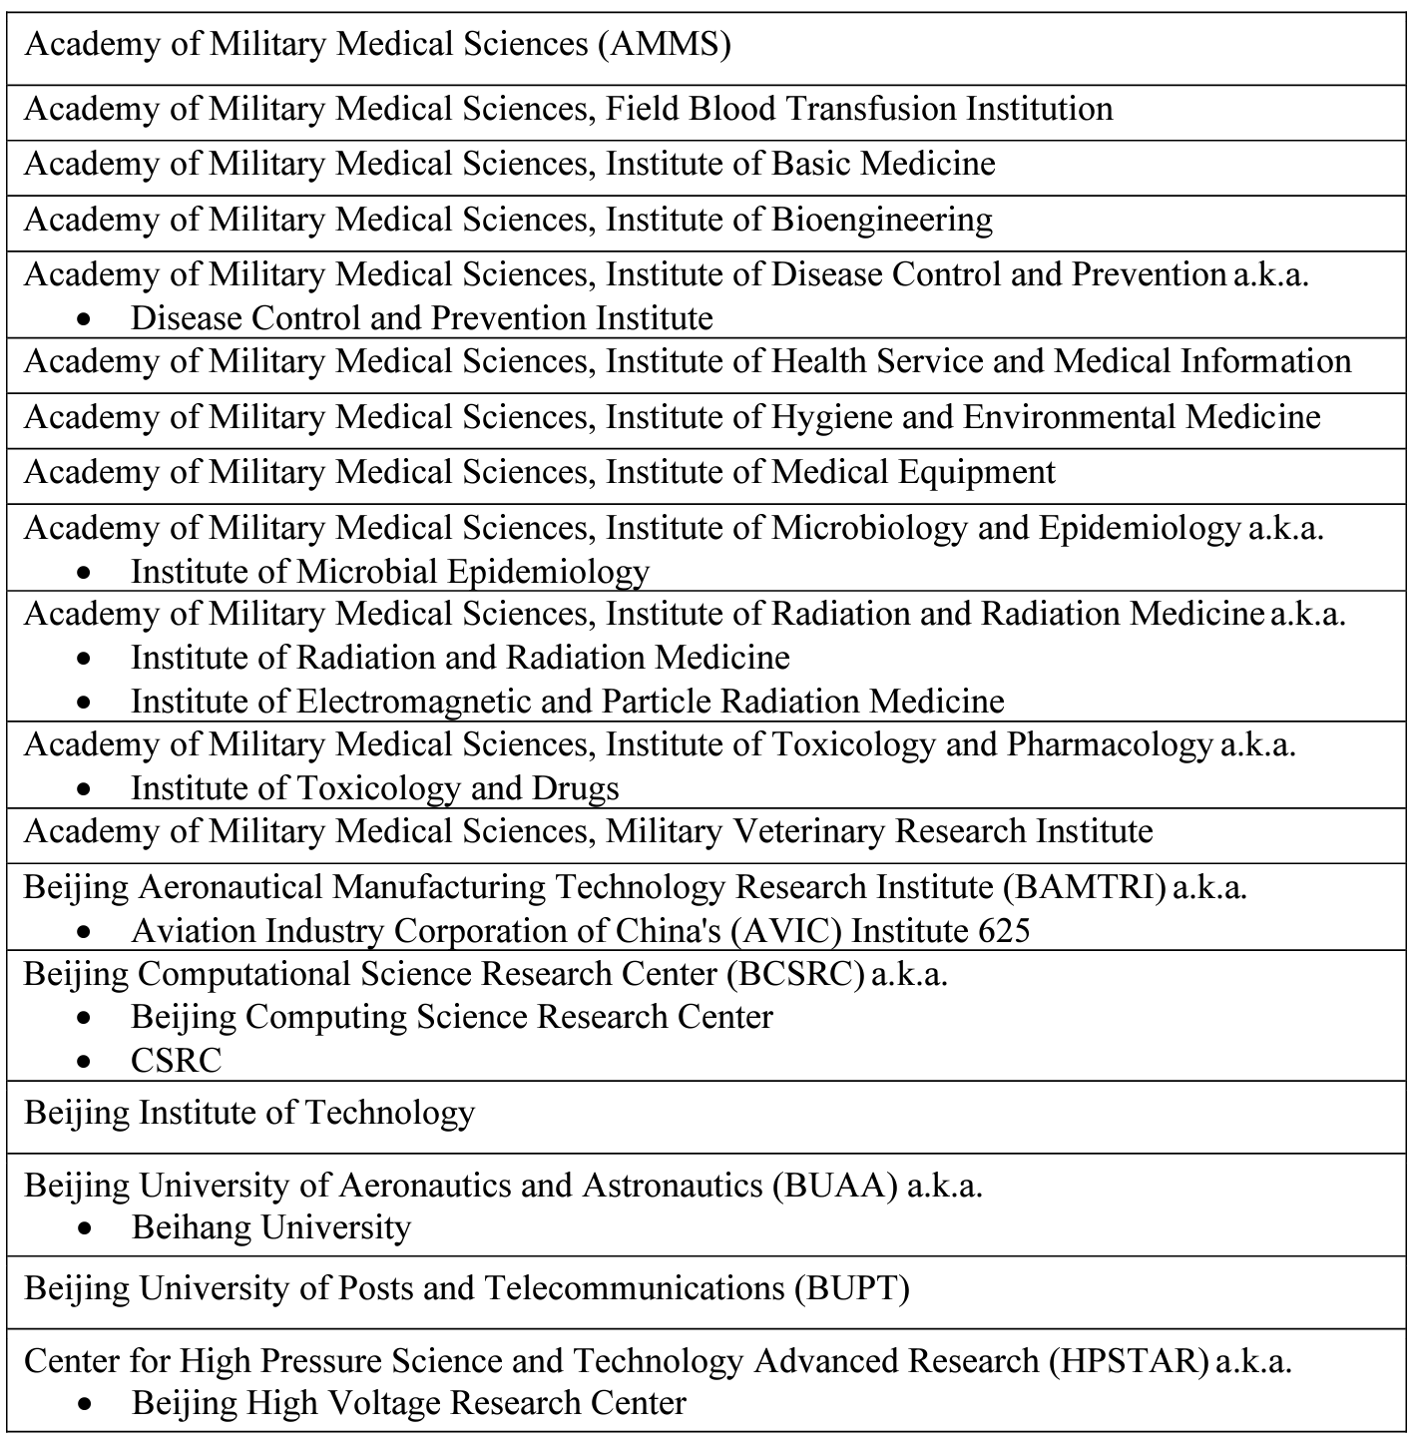
Table 1: List of Institutions of the People’s Republic of China, Russian Federation, and other Countries with Specific Characteristics - Page 1 of 2
UNCLASIFIED/Distribution A

Slide 23
Table 1: List of Institutions of the People’s Republic of China, Russian Federation, and other Countries with Specific Characteristics - Page 2 of 2
UNCLASSIFIED/Distribution A

Slide 24
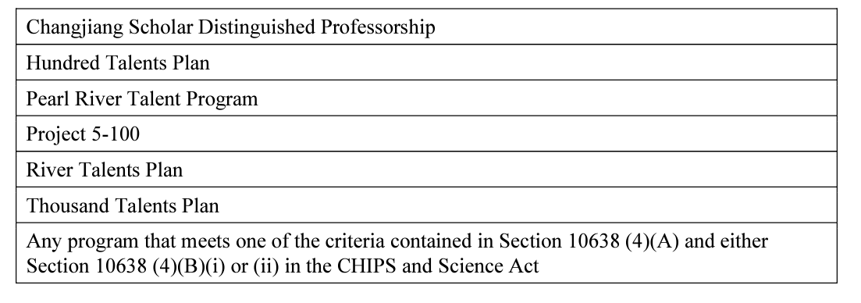
Table 2: Foreign Talent Programs that Pose a Threat to National Security Interests of the United States
UNCLASSIFIED/Distribution A

Slide 25
Contact Us
Contact the Academic Liaison for any questions/concerns/issues pertaining to research security at institutions of higher education at:
osd.mc-alex.ousd-r-e.mbx.academic-liaison@mail.mil
DoD research security information:
Academic research security pertaining to fundamental research
Basic Research Office website at: https://basicresearch.defense.gov/Programs/Academic-Research-Security/
Efforts to balance the promotion and protection of critical and emerging technology through the technology development cycle
Science and Technology Program Protection Office’s Maintaining Technology Advantage website at: https://rt.cto.mil/stpp/mta/#
DoD’s public release of the Policy for Risk-Based Security Reviews including the decision matrix and 1286 lists: Defense.gov: https://www.defense.gov/News/Releases/Release/Article/3445601/department-of-defense-strengthening-efforts-to-counter-unwanted-foreign-influen/

Slide 26
Back up slides
UNCLASSIFIED/Distribution A

Slide 27
Legislative Direction: Section 1286
UNCLASSIFIED
2019 NDAA Section 1286 as amended – Initiative to Support Protection of National Security Academic Researchers from Undue Influence and other Security Threats
Directs the Department to establish an initiative
(1) to support protection of intellectual property, controlled information, key personnel, and information about critical technologies relevant to national security;
(2) to limit undue influence, including through foreign talent programs, by countries to exploit United States technology within the Department of Defense research, science and technology, and innovation enterprise; and
(3) to support efforts toward development of domestic talent in relevant scientific and engineering fields.
Directs the department to develop and publish
List of problematic foreign Influence programs
List of academic institutions that have a history of improper technology transfer
Directs Annual Report
UNCLASSIFIED/Distribution A

Slide 28
Legislative Direction: CHIPS and Science Act of 2022
UNCLASSIFIED
Creating helpful incentives to produce semiconductors (CHIPS) and Science Act of 2022
Subtitle D – Research Security
SEC. 10631. REQUIREMENTS FOR FOREIGN TALENT RECRUITMENT PROGRAMS.
(a) PURPOSE.—The purpose of this subtitle is to direct actions to prohibit participation in any foreign talent recruitment program by personnel of Federal research agencies and to prohibit participation in a malign foreign talent recruitment program by covered individuals involved with research and development awards from those agencies.
(b) GUIDANCE.—Not later than 180 days after the date of the enactment of this Act, the Director of the Office of Science and Technology Policy, in coordination with the interagency working group established under section of the National Defense Authorization Act for Fiscal Year 2020 (42 U.S.C. 6601 note; Public Law 116–92), shall publish and widely distribute a uniform set of guidelines for Federal research agencies regarding foreign talent recruitment programs. Such policy guidelines shall—
……………
UNCLASSIFIED/Distribution A

Slide 29
Legislative Direction: Section 223
UNCLASSIFIED
2021 NDAA Section 223 – Disclosure of Funding Sources in Application for Federal Research And Development Awards
(a) DISCLOSURE REQUIREMENT.—Each Federal research agency shall require, as part of any application for a research and development award from such agency—
(1) that each covered individual listed on the application—
(A) disclose the amount, type, and source of all current and pending research support received by, or expected to be received by, the individual as of the time of the disclosure;
(B) certify that the disclosure is current, accurate, and complete; and
(C) agree to update such disclosure at the request of the agency prior to the award of support and at any subsequent time the agency determines appropriate during the term of the award; and
(2) that any entity applying for such award certify that each covered individual who is employed by the entity and listed on the application has been made aware of the requirements under paragraph (1).
(b) CONSISTENCY.—The Director of the Office of Science and Technology Policy, acting through the National Science and Technology Council and in accordance with the authority provided under section 1746(a) of the National Defense Authorization Act for Fiscal Year 2020 (Public Law 116–92; 42 U.S.C. 6601 note) shall ensure that the requirements issued by Federal research agencies under subsection (a) are consistent.
UNCLASSIFIED/Distribution A

Slide 30
Legislative Direction: Section 1746-Securing American Science and Technology
UNCLASSIFIED
2020 NDAA Section 1746 – Securing American Science and Technology
INTERAGENCY WORKING GROUP.— (1) IN GENERAL.—The Director of the Office of Science and Technology Policy, acting through the National Science and Technology Council, in consultation with the National Security Advisor, shall establish or designate an interagency working group to coordinate activities to protect federally funded research and development from foreign interference, cyber attacks, theft, or espionage and to develop common definitions and best practices for Federal science agencies and grantees, while accounting for the importance of the open exchange of ideas and international talent required for scientific progress and American leadership in science and technology.
NATIONAL ACADEMIES SCIENCE, TECHNOLOGY AND SECURITY ROUNDTABLE.— IN GENERAL.—The National Science Foundation, the Department of Energy, and the Department of Defense, and any other agencies as determined by the Director of the Office of Science and Technology Policy, shall enter into a joint agreement with the Academies to create a new ‘‘National Science, Technology, and Security Roundtable’’
PURPOSE.—The purpose of the roundtable is to facilitate among participants—
exploration of critical issues related to protecting United States national and economic security while ensuring the open exchange of ideas and international talent required for scientific progress and American leadership in science and technology;
identification and consideration of security threats and risks involving federally funded research and development, including foreign interference, cyber attacks, theft, or espionage;
identification of effective approaches for communicating the threats and risks identified in subparagraph (b) to the academic and scientific community, including through the sharing of unclassified data and relevant case studies;
sharing of best practices for addressing and mitigating the threats and risks identified in subparagraph (B); and
examination of potential near- and long-term responses by the Government and the academic and scientific community to mitigate and address the risks associated with foreign threats.
UNCLASSIFIED/Distribution A

Slide 31
Research Security Review
Unclassified
Decision Matrix to Inform Fundamental Research Proposal Mitigation Decisions
Table 1: Decision Matrix to Inform Fundamental Research Proposal Mitigation Decisions
 | Factors for Assessing a Covered Individual’s Associations, Affiliations, Collaborations, Funding, and the Policies of the Proposing Institution that Employs the Covered Individual
 | Factor 1: Foreign Talent Recruitment Programs | Factor 2: Funding Sources | Factor 3: Patents | Factor 4: Entity Lists
Prohibited Factors | For the Period after 9 Aug 2024: Indicators of participation in a malign foreign talent recruitment program (MFTRP) meeting any of the criteria in Sec. 10638(4)(A)(i)-(ix) of the CHIPS and Science Act of 2022. Policy of proposing institution employing the covered individual does not prohibit participation in an MFTRP.
Factors discouraged by DoD policy, mitigation measures required, rejection of proposal required if no mitigation possible | For the period after 9 Aug 2022:¹ Indicator(s)² of participation³ in a foreign talent recruitment program (FTRP) meeting any of the criteria in Sec. 10638(4)(A)(i)-(ix) of the CHIPS and Science Act of 2022. | Indicator(s) that the covered individual is currently receiving funding from a foreign country of concern (FCOC) or an FCOC-connected entity. | Patent application(s) or patent(s) not disclosed in proposal, that resulted from research funded by the U.S. Government (USG), that were filed in an FCOC prior to filing in the U.S. or filed on behalf of an FCOC-connected entity. | For the period after 9 Aug 2022: Indicator(s) of association with an entity on: the U.S. Bureau of Industry and Security (BIS) Entity List,⁴ the Annex of Executive Order (EO) 14032⁵ or superseding EOs, or Sec. 1260H of the National Defense Authorization Act (NDAA) for Fiscal Year (FY) 2021.⁶
 |  |  |  | For the period after 10 Oct 2019:⁶ Indicator(s) of affiliation with an entity on: the U.S. BIS Entity List, the Annex of EO 14032 or superseding EOs, or Sec. 1260H of the NDAA for FY 2021.
Mitigation measures recommended | For the period between 10 Oct 2019⁷ and 9 Aug 2022: Indicator(s) of participation in an FTRP meeting any of the criteria in Sec. 10638(4)(A)(i)-(ix) of the CHIPS and Science Act of 2022. | For the period between 10 Oct 2019 and 9 Aug 2022: Indicator(s) that the covered individual received funding from an FCOC or an FCOC-connected entity. | Patent application(s) or patent(s) disclosed in proposal, that resulted from research funded by the USG, that were filed in an FCOC prior to filing in the U.S. or on behalf of an FCOC-connected entity. | For the period between 10 Oct 2019 and 9 Aug 2022: Indicator(s) of association with an entity on: the U.S. BIS Entity List, the Annex of EO 14032 or superseding EOs, or Sec. 1260H of the NDAA for FY 2021.
 |  |  |  | For the period prior to 10 Oct 2019: Indicator(s) of an affiliation with an entity on: the U.S. BIS Entity List, the Annex of EO 14032 or superseding EOs, or Sec. 1260H of the NDAA for FY 2021.
Mitigation measures recommended | For the period after 9 Aug 2022: Policy of proposing institution employing the covered individual does not prohibit participation in an MFTRP.
Mitigation measures suggested | For the period after 10 Oct 2019: Covered individual’s co-author(s)⁸ on publications in scientific and engineering (S&E) journals are participants in an MFTRP or an FTRP meeting any of the criteria in Sec. 10638(4)(A)(i)-(ix) of the CHIPS and Science Act of 2022. |  | Patent application(s) or patent(s) not disclosed in fundamental research project proposal, that resulted from research funded by the USG, that were filed in a non-FCOC prior to filing in the U.S. or on behalf of an entity in a non-FCOC. Co-patent applicant with a person on the U.S. BIS Denied Persons List.⁹ | For the period after 10 Oct 2019: Covered individual’s co-author(s) on publications in S&E journals are affiliated with an entity on: the U.S. BIS Entity List, the Annex of EO 14032 or superseding EOs, or Sec. 1260H of the NDAA for FY 2021. Covered individual is a co-author on a publication in an S&E journal with a person on the U.S. BIS Denied Persons List
 | For the period prior to 10 Oct 2019: Indicator(s) of participation in an FTRP meeting any of the criteria in Sec. 10638(4)(A)(i)-(ix) of the CHIPS and Science Act of 2022. | For the period prior to 10 Oct 2019: Indicator(s) that the covered individual received limited or partial funding from an FCOC or an FCOC-connected entity. |  | For the period prior to 10 Oct 2019: Indicator(s) of association with an entity on: the U.S. BIS Entity List, the Annex of EO 14032 or superseding EOs, or Sec. 1260H of the NDAA for FY 2021.
No mitigation needed | No indicator(s) of participation in an MFTRP; or No indicator(s) of participation in an FTRP meeting any of the criteria in Sec. 10638(4)(A)(i)-(ix) of the CHIPS and Science Act of 2022. | No indicator(s) that the covered individual is receiving or has received funding from an FCOC or an FCOC-connected entity. | All patent application(s) or patent(s), resulting from research funded by the USG have been filed in the U.S. prior to filing in any other country. | No indicator(s) of any association or affiliation with an entity on: the U.S. BIS Entity List, the Annex of EO 14032 or superseding EOs, or Sec. 1260H of the NDAA for FY 2021, and no indicator(s) of publication in S&E journals co-authored with an individual on the U.S. BIS Denied Persons List.
USD(R&E) released a policy on June 8, 2023 requiring that all fundamental research proposals selected for funding undergo a research security review to identify conflicts of interest arising from foreign influence.
DoD developed a decision matrix to guide DoD Components in determining how to identify and assess risk of foreign influence in fundamental research projects at U.S. universities
The review considers associations, affiliations, patent applications, funding sources, and participation in foreign talent plans
The decision matrix is accompanied by a list of foreign institutions that have been confirmed as engaging in problematic activity
UNCLASSIFIED/Distribution A

