Slide 1
Updates on NIH Data Management and Sharing (DMS)
December 7, 2022

Slide 2
Webinar Logistics
Format:
Welcome
Comments from WSU experts
Live Q&A session
Logistics:
Please use Q&A Box to submit questions
Attendees can “upvote” questions to help us prioritize
Chat to hosts if you experience technical or logistic issues
Webinar team providing resource links in the chat
Recording Information and
Resource Slides will be
made available at our new website: research.wsu.edu/DMS
Notes:
https://research.wsu.edu/dms/

Slide 3
Agenda
Welcome, Kay Hecox, Office of Research Support and Operations (ORSO)
NIH DMS Policy Introduction with Christopher Keane, Office of Research
ORAP Assistance with Sofia D’Ambrosio, Office of Research Advancement and Partnerships
Proposal budgeting and support with Matt Michener, ORSO
ATO/Campus/Local Support Perspective with Bryan Valley, WSU Spokane
Library Support and Repository Functions with Talea Anderson and Alex Merrill, WSU Libraries
How Central IT supports DMS at WSU with Tony Opheim, Central IT
Faculty feedback tips and resources, Dan Nordquist, ORSO
Q&A moderated by Derek Brown, ORSO

Slide 4
Introduction – Vice President for Research WSU and Vice Chancellor for Research, WSU Pullman Christopher Keane

Slide 5
Introduction to NIH DMS Policy
Final NIH Policy for Data Management and Sharing (NOT-OD-21-013), release date 10/29/20. All submissions received 1/25/23 or later will require these plans.
Part of a “Culture Shift” of making the practice of data management and responsible data sharing the norm.
Our goals today:
Raise awareness of the policy changes
Highlight the important elements of the policy
Communicate WSU resources to assist in the development of your plans
Communicate roles and responsibilities of managing data
Reminder: Not just NIH (todays focus) - 2022 OSTP Public Access Memo Release, from 8/25/22.
Notes:
Final NIH Policy for Data Management and Sharing (NOT-OD-21-013): https://grants.nih.gov/grants/guide/notice-files/NOT-OD-21-013.html
2022 OSTP Public Access Memo Release, from 8/25/22: https://www.osti.gov/2022-OSTP-Public-Access-Memo-Release

Slide 6
DMS Policy Scope
Applies to all research, funded or conducted in whole or in part by NIH, that results in the generation of “scientific data”, defined as:
“the recorded factual material commonly accepted in the scientific community as of sufficient quality to validate and replicate research findings, regardless of whether the data are used to support scholarly publications.”
Sofia D’Ambrosio, ORAP, will discuss what types of data to include in your plans in more detail.

Slide 7
DMS Policy Requirements
Submission of a two-page data management and sharing plan with all applications for funding starting 1/25/23.
Those without will not be considered for funding.
Sofia D’Ambrosio, ORAP, will discuss DMS templates and other resources available.
Compliance with the DMS plan approved by the funding NIH Institute, Center, or Office.
Failure to provide updates in grant reporting may result in enforcement actions, including the addition of special terms and conditions or award termination.
Failure to deposit data after the end of the funding period may negatively influence future opportunities.

Slide 8
ORAP Information and Assistance – Sofia D’Ambrosio, Proposal Consultant

Slide 9
Scientific Data
"recorded factual material commonly accepted in the scientific community as of sufficient quality to validate and replicate research findings, regardless of whether the data are used to support scholarly publications."

Slide 10
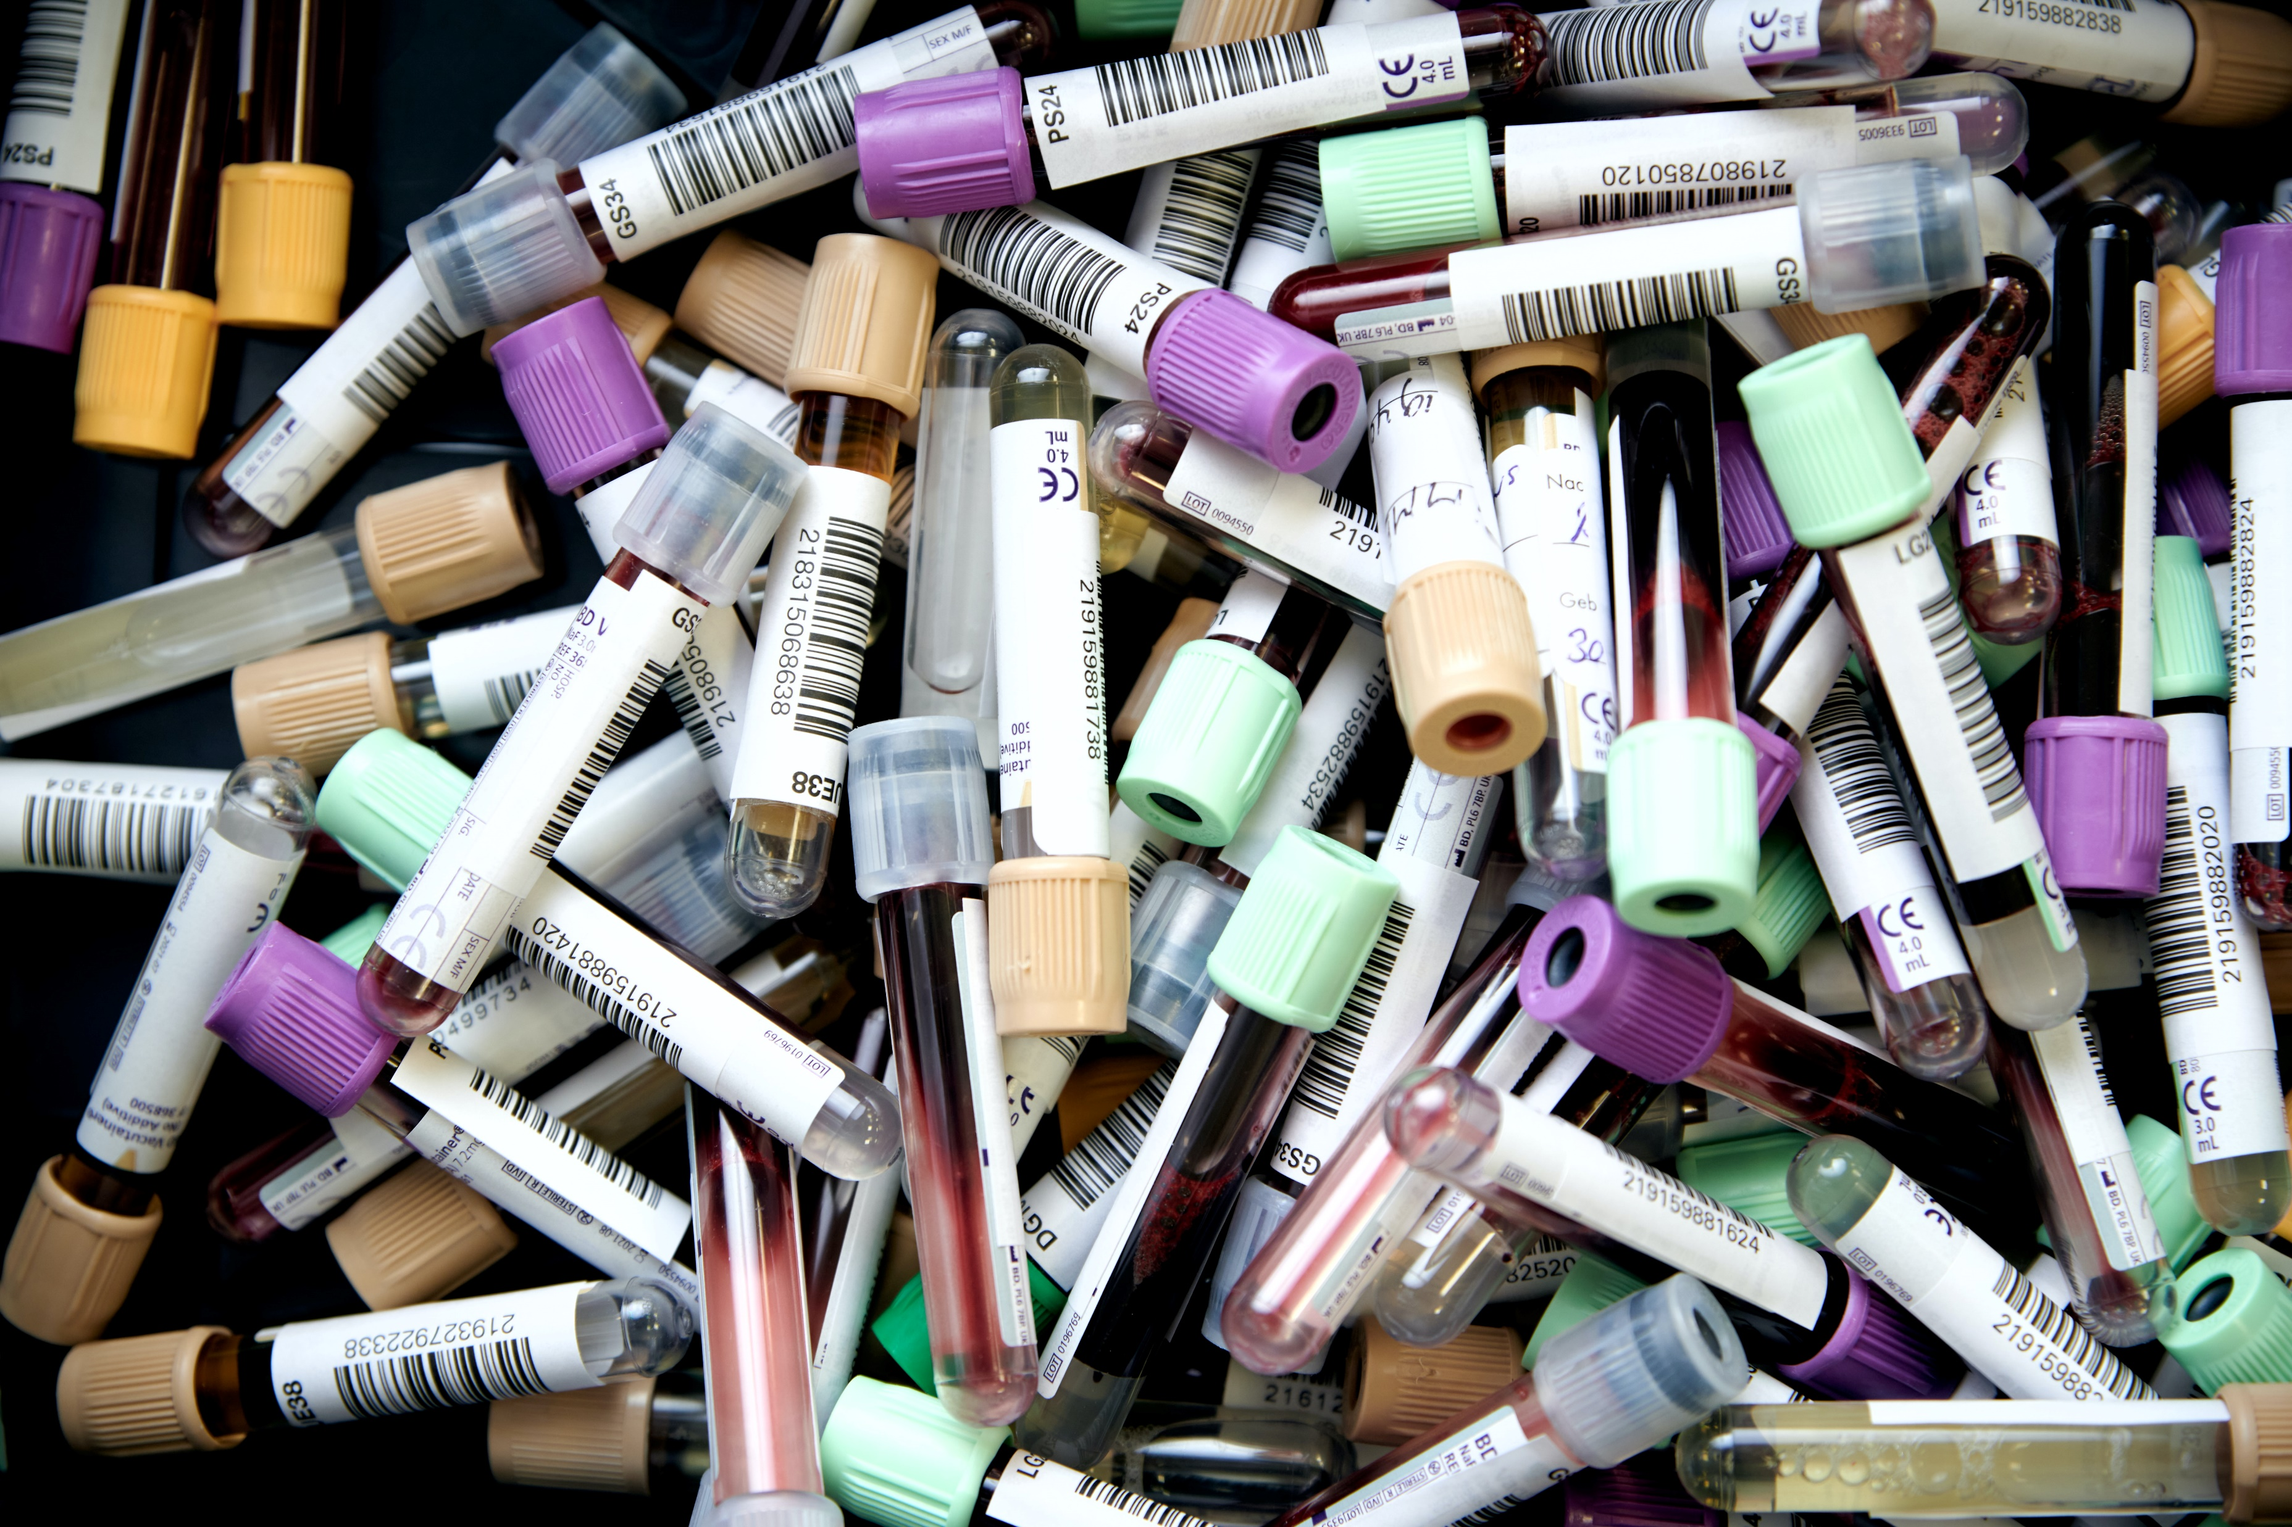
Not Scientific Data
Lab notebooks
Preliminary analyses
Physical objects/specimens
Completed case reports
Publication drafts
Peer reviews
Future research plans
Colleague communications

Slide 11
All data need to be managed…
but (with justification!)
not all data need to be shared.

Slide 12
Acceptable Reasons to Limit Sharing of Scientific Data
Informed & existing consent
Legal compliance
Privacy/safety concerns
Contractual, licensing, or data use agreements
NIH program stipulations (SBIR, STTR)
Cannot be digitized practically
Tribal considerations (NOT-OD-22-064)

Slide 13
Unacceptable Reasons to Limit Sharing of Scientific Data
Data too small
Data would not be widely used
No suitable repository

Slide 14
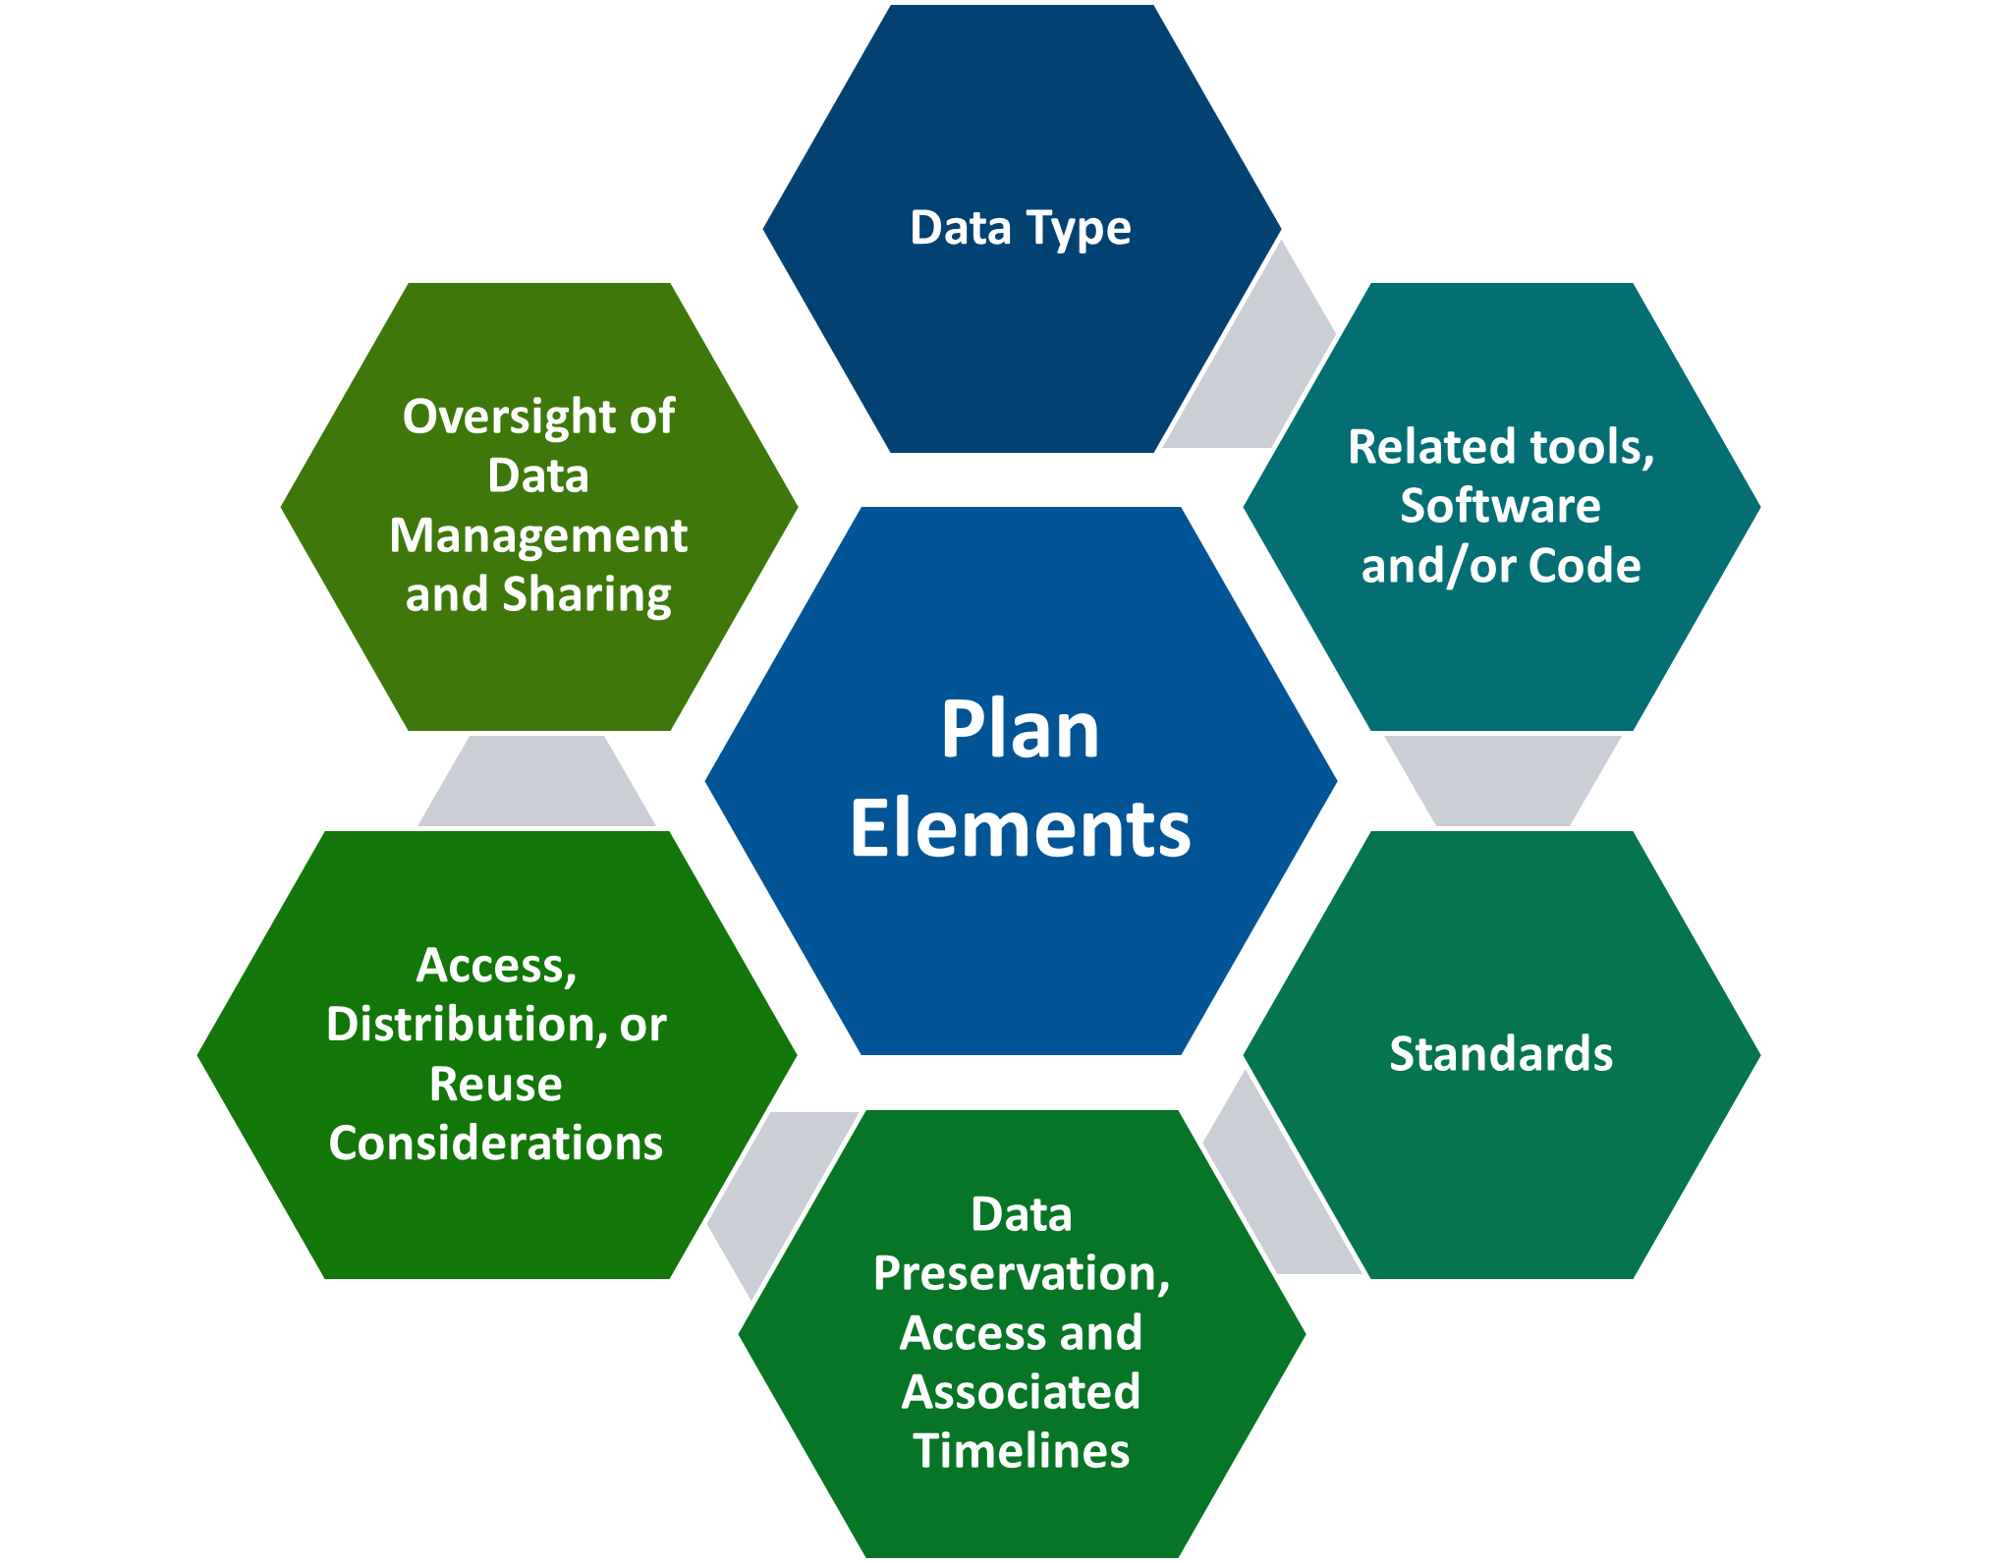
DMS Plan Elements
2 pages

Slide 15
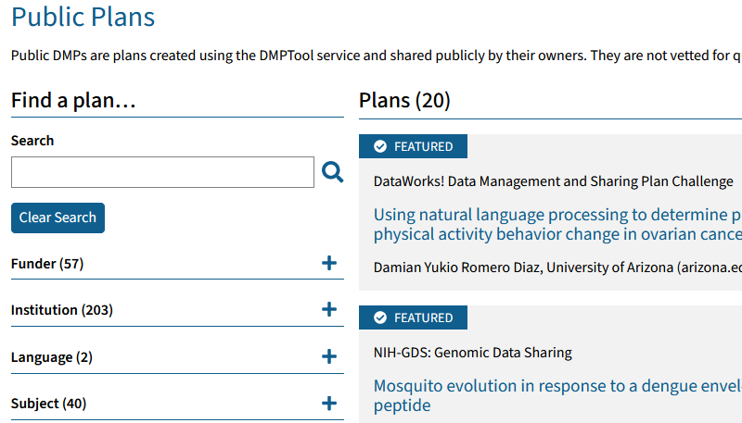
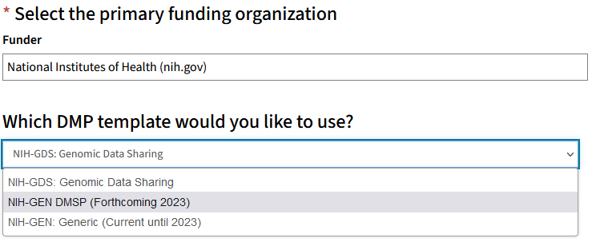
Resources
dmptool.org
Templates
Examples
Notes:
https://dmptool.org/

Slide 16
Resources
dmptool.org
Webinar:
Creating Data Management Plans with DMPTool
Dec 13th, 10-11am PST
nnlm.gov/training
Templates
Examples

Slide 17
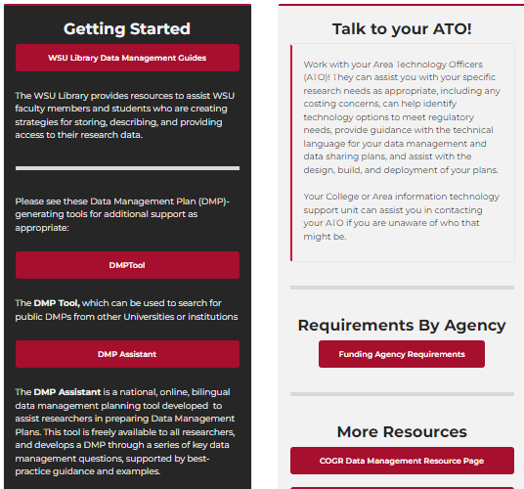
Resources
research.wsu.edu/dms
Table of requirements for NIH & other federal agencies
Links to other DMS resources

Slide 18
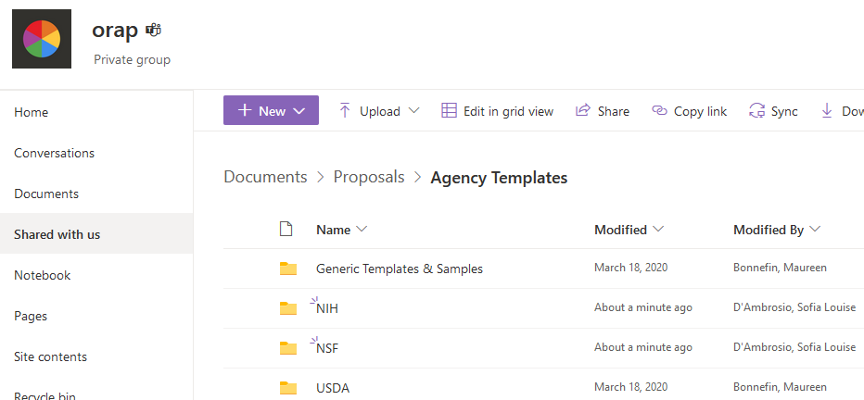
Resources
ORAP Proposal Development Toolbox
Templates for NIH & other agencies
Access via:
https://orap.wsu.edu/toolbox/
research.wsu.edu/dms
Notes:
https://orap.wsu.edu/toolbox/
https://research.wsu.edu/dms/

Slide 19
Resources
Contact ORAP for help!
Successful DMSP from specific solicitations
Draft DMSP feedback
Other questions
or.orap@wsu.edu
Samuel Rodriguez-Flecha, Ph.D.
Interim Director
Sofia D’Ambrosio, Ph.D.
Proposal Consultant
Emily Brashear
Faculty Research Development Specialist

Slide 20
Proposal Budgeting with ORSO – Matt Michener, Assistant Director

Slide 21
Proposal Budgeting for NIH Data Management and Sharing Costs
The NIH website on Budgeting for Data Management and Sharing (DMS) is located HERE, showing what is allowable and unallowable for proposals due before or after Jan 25, 2023.
Budgeting for these DMS costs is done two ways:
Detailed R&R Budget Model
-Budgeted as “Other direct Cost”
-Include a brief summary of the DMS plan and description of the requested DMS Costs within the Budget Justification with the dollar amount
-File named “Data Management and Sharing Costs”
Modular Budget Model
-Budgeting is to be included in the “Additional Narrative Justification” attachment with a description of DMS costs
-Include the dollar amount
-Include a brief summary of the DMS plan
Notes:
https://sharing.nih.gov/data-management-and-sharing-policy/planning-and-budgeting-for-data-management-and-sharing/budgeting-for-data-management-sharing

Slide 22
Area Technology Officer (ATO)/Local Support with Bryan Valley, Director of IT Infrastructure, ITS WSU Spokane

Slide 23
ATO Local Support
Engage with your ATO early in the process.
Technology options to meet regulatory needs.
Assistance with the technical language for your data management and sharing plan.
Design, build, and deployment assistance.

Slide 24
WSU Libraries Support – Talea Anderson, Scholarly Communication Librarian and Alex Merrill, Head of Systems and Technical Operations WSU Libraries

Slide 25
Research Exchange
Research Exchange is a repository that any WSU researcher can use to deposit research materials.
Available services:
DOIs/persistent identifiers
Long-term storage
Assistance from WSU Libraries
Notes:
https://rex.libraries.wsu.edu/esploro/

Slide 26
Research Exchange
Dataset deposits should be <200 GB, cleaned and anonymized for public access.
For more information: Research Exchange FAQ.
Use this Research Exchange submissions form to reach WSU Libraries or contact Talea Anderson, talea.anderson@wsu.edu.
Notes:
https://libraries.wsu.edu/scholarly-communication/research-exchange-faq
https://libraries.wsu.edu/research-exchange-submissions/

Slide 27
How Central IT Supports WSU – Tony Opheim, Associate Vice President for Infrastructure and Deputy Chief Information Officer

Slide 28
Regulated Data Environments
Tailored to your workflows.
200+ services, highly flexible.
On-demand, direct costs.
Combine native and self-managed tools.
Consultation and cost forecasts provided to shape your direct costs.

Slide 29
Information Security Policies
EP8: System Data Policy
Establishes data administration policy, roles and responsibilities, classification of data
BPPM 45.35: Managing Research Records
University ownership and stewardship of research records
BPPM 87.01: Information Security Roles, Responsibilities, and Definitions
Defines roles of CIO, CISO, Information Owner, Data Custodian
EP37: Information Security Policy
Defines information security framework and compliance requirement
Notes:
WSU Executive Policy 8, ‘WSU System Data Policies’: https://policies.wsu.edu/prf/index/manuals/executive-policy-manual/ep08/
WSU Executive Policy 37, ‘WSU Information Security Policy’: https://policies.wsu.edu/prf/index/manuals/executive-policy-manual/ep37/
WSU BPPM 45.35, ‘Managing Research Records’: https://policies.wsu.edu/prf/index/manuals/business-policies-and-procedures-manual/bppm-45-35/
WSU BPPM 87.01, ‘WSU Information Security Roles, Responsibilities, and Definitions’: https://policies.wsu.edu/prf/index/manuals/business-policies-and-procedures-manual/bppm-87-01/

Slide 30
Faculty Feedback and Tips – Dan Nordquist, Associate Vice President for Research

Slide 31
Faculty Feedback and Tips
For those of you working with Tribes/Native Nations, please be sure and review WSU EP41 “Policy on Tribal Engagement, Consultation, and Consent for Joint WSU-Tribal Research Activities and Projects” and contact the WSU Office of Tribal Relations before proceeding.
Many NIH Institutes/Centers/Offices (ICO’s) already have data sharing policies, the idea of sharing data is not a new idea. This is more of a reinforcement of what NIH has expected for some time.
PIs should check with their specific funding institute to make sure they are compliant with their expectations. The larger NIH policy is general, but NIAAA, for example, has very clear and direct expectations about depositing one’s data into their archive. This includes how to organize the data, what data elements are included, etc.
While the university provides the necessary infrastructure to be compliant with NIH policy, this is a PI driven process.
Notes:
https://policies.wsu.edu/prf/index/manuals/executive-policy-manual/ep41/

Slide 32
Faculty Feedback and Tips
Remember FAIR principles:
Findable
Accessible
Interoperable
Reusable
FAIR principles point the way forward for facilitating data sharing more systematically.
These principles put specific emphasis on enhancing the ability of machines to automatically find and use your data, in addition to supporting its reuse by other individuals.

Slide 33
Faculty Feedback and Tips
Submit elements of the plan in tables, figures, or flowcharts where possible.
Consider data sharing agreements.
Rely on experience of co-investigators who routinely deposit data into specialized databases.
Data can be dangerously misused. PI’s should practice careful judgment before making their data completely available.

Slide 34
How to Prepare
Familiarize yourself with the new DMS Policy
Identify and connect with those at WSU that can help
Practice drafting a new Data Management Plan
Review your prior data sharing practices and expectations to consider what you might need to update going forward
Get involved and network

Slide 35
DMS Resources
Brand new: WSU DMS Website
NIH Data Sharing Learning Resource
WSU Library Data Management Guides
NIH Data Management and Sharing Policy
COGR Data Management Resources
DMP Tool
DMP Assistant
Funding Agency Requirements
Notes:
Brand new WSU DMS website: this is our WSU landing page for all things DMS related. We will have resources, tools, updates, and links for more information all on this one page for your convenience.
https://research.wsu.edu/dms/
NIH Data Sharing Learning: this is where the NIH routinely uploads their webinars and learning tools.
https://sharing.nih.gov/about/learning
WSU Library guides: this is WSU Library page for helping WSU faculty learn how to better manage their research team's data throughout all phases of the research lifecycle.
https://libguides.libraries.wsu.edu/rdmlibguide/dmp
NIH Data management and sharing policy page: this a great tool to learn what is expected of investigators and institutions under the 2003 NIH Data Sharing Policy and the 2023 NIH Data Management & Sharing Policy
https://sharing.nih.gov/data-management-and-sharing-policy/about-data-management-and-sharing-policies/data-management-and-sharing-policy-overview
COGR data management resources: Includes policies, supplements, FAQs and other resources from the Council on Government Relations on new policies.
https://www.cogr.edu/nih-data-management-and-sharing
The DMP tool can help Create Data Management Plans that meet requirements and promote your research.
https://dmptool.org/
The DMP Assistant is a national, online, bilingual data management planning tool developed by the Digital Research Alliance of Canada (the Alliance) in collaboration with host institution University of Alberta to assist researchers in preparing data management plans (DMPs).
https://assistant.portagenetwork.ca/
The funding agency requirements are a list of different federal funders and what they currently do or do not expect from a research proposal.
https://research.wsu.edu/dms-funding-agency-requirements/

Slide 36
Q&A – Derek Brown, Research Operations Manager

