Slide 1
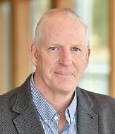
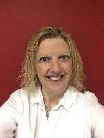
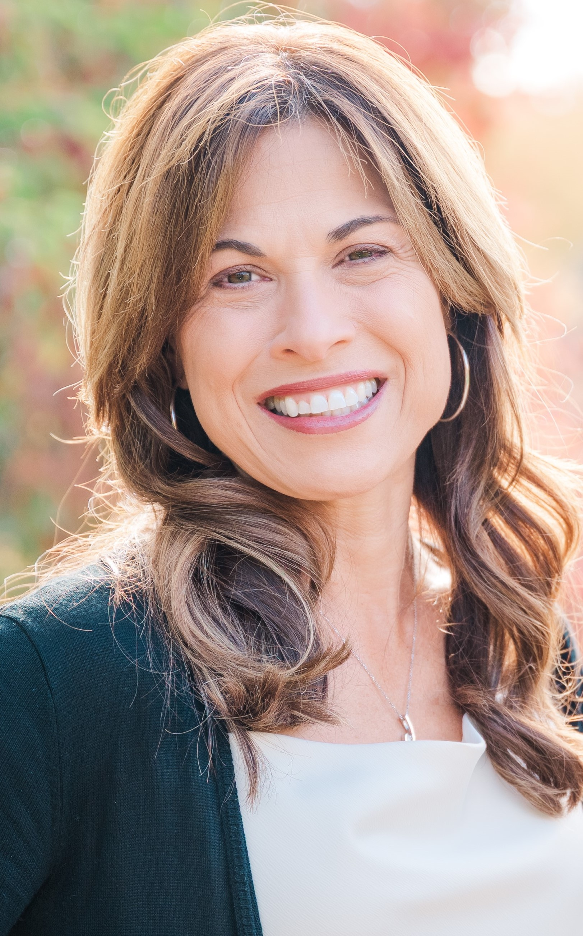
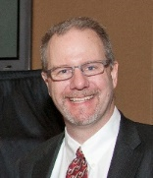
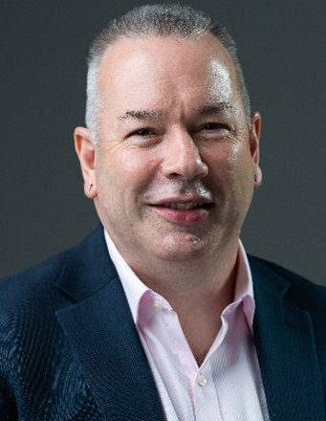
WSU Office of Research Org Chart
Interim Vice President for Research Regents Professor WSU Research Integrity Officer (RIO)
Dr. Michael P. Wolcott
Deputy VPR/VCR for Operations
Dan Nordquist
Office of Research Integrity
L. O’Loughlin (Deputy RIO)
E. Vander Zanden
J. Smith-Kaprosy (AG)
Institutional Animal Care
and Use Committee
Institutional Review Board
Institutional Biosafety Committee
Radiation Safety Committee
Executive Assistant
T. Huffman
Communications
K. Christen
K. Hunt
T. DeVries
G. Thatcher
Director Administrative Services
M. Boyd
Faculty Fellows
A. Boyd (CAS)
A. Cousins (SBS)
J. Dasgupta (Math)
B. French (COE)
Administrative
T. Druffel, K. Shelton,
D. Keeton, D. Zinn
Research Advancement & Partnerships
K. Christen
Research Support and Operations
D. Nordquist
Research Assurances
M. Kluzik
Campus Veterinarian
N. Woodford
Office of Commercialization
National Lab Partnerships
J. Male
Vice President for Research and the Deputy VPR of Operations
Notes:
Revised Office of Research organization chart currently DOES NOT reflect THE merger of the Office of Commercialization (OC) and the Innovation and Research Engagement Office (IREO) with the new name “Office of Commercialization and Innovation.” This can be updated when the formal name change is complete/approved.

